Slide 1
Hot summer days
On average days are hotter in summer.
Notes:
https://pixabay.com/photos/people-kids-child-girl-boy-baby-2599687/

Slide 2
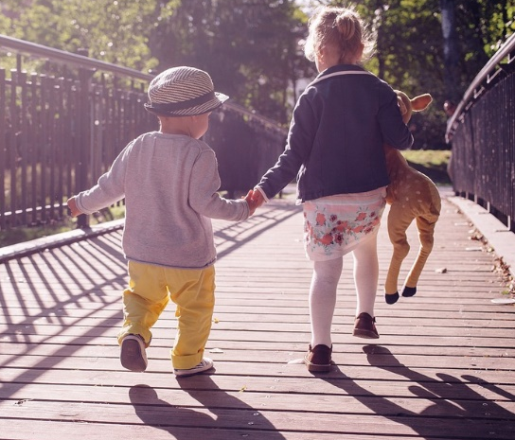
Hot summer days
Why is it hotter in summer?
I am sure this is right
I think this is right
I think this is wrong
I am sure this is wrong
A
Days are longer
B
The Sun is hotter
C
The Earth is closer to the Sun
D
The Sun is higher in the sky
E
More radiation from the Sun reaches the ground

